Slide 1
Eclipse import of project

Slide 2
Import of BlueJ project into Eclipse
Create an Eclipse project with a meaningful name
Navigate to the source folder in the project structure
Right click and select import

Slide 3
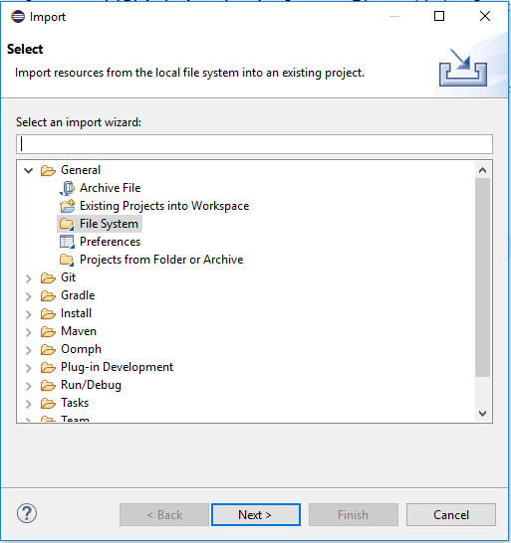
At the wizard select from file system

Slide 4
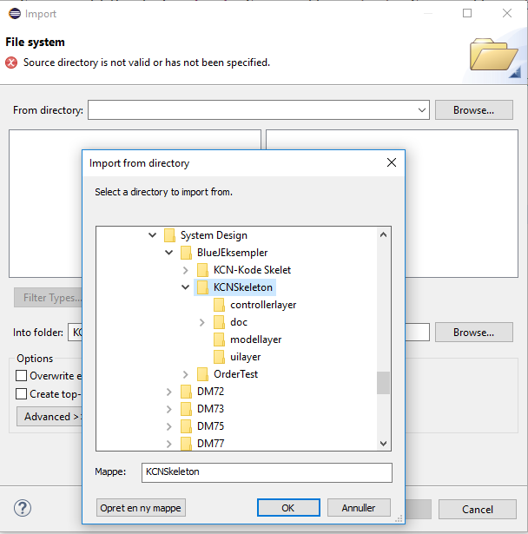
Navigate to the folder where the project is

Slide 5
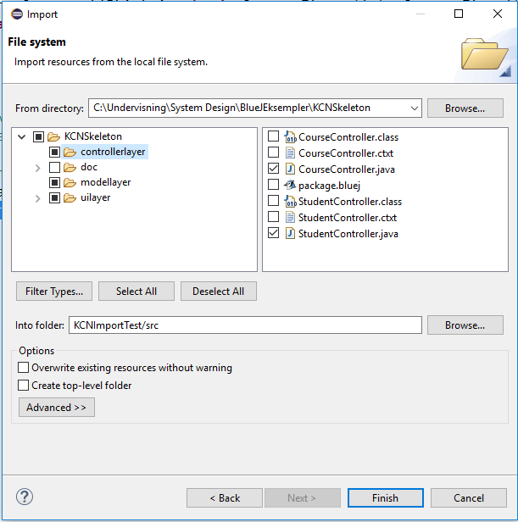
Import continued….
Click the package you want, only java
files
Or filter on java types

Slide 6
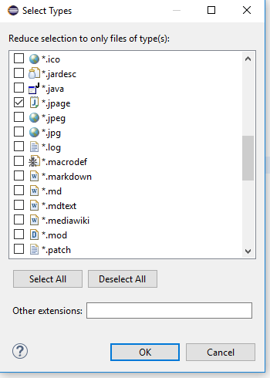
Filter on type Java

Slide 7
Import continued
To run the solution right click on project name and choose run as java application
If there is no main method you must implement one (typically in the main UI, please see the next slide)
To open the gui in windows builder choose open with and then windos builder

Slide 8
Dummy main method
public static void main(String[] args) {
//TODO insert code that initializes
the program and start it
CourseUI ui = new CourseUI();
ui.start();
}
Example code which initializes the MainUI and start it

